Slide 1


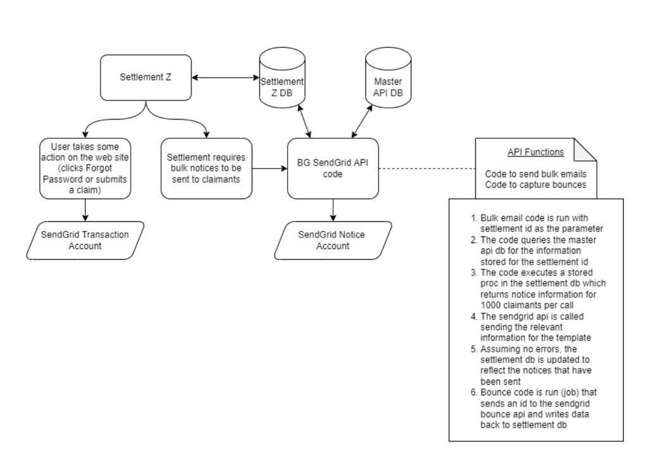
.NET - Integrating new Modules and API’s
Natesh Ghanta
NestorTechnologiesInc 15CorporatePlaceS Suite#330 Piscataway NJ08854
Developed the new API’s for transactional purposes.
Worked with C#, ASP.Net, ADO.Net,ASP.net MVC, SQL Db,Azure.
Created the new SMTP cocept for the transcational emails meeting the business requirements.
Created the new SMTP concept for the business transactional emails.
Migrated from the Campaigner to Pacer Sendgrid features.
Interacted with the various programming and technologies like C#, XML, Json formats.
Created the templates for business emails using Sendgrid API’s.
Tools Used for the Dvelopment:
Microsoft Azure
Microsoft Visual Studio
Microsoft Sql Server Management Studio
Postman, Jenkins, Git
https://docs.sendgrid.com/for-developers/sending-email/api-getting-started#how-to-send-an-api-email
https://www.postman.com/postman/workspace/postman-public-workspace/documentation/12959542-c8142d51-e97c-46b6-bd77-52bb66712c9a
Dr. Cindy Tu (Program Instructor)
Sri Panyala (Manager),
Randy (Team Lead)
https://github.com/NateshGhanta/Poster-Presentation_GHANTA.git

